Slide 1
ECE2021 Machine Learning Project
Tracking Barbell Exercises
Group Members:
Lê Quốc Định - 10221009
Phạm Nam Nhật - 10221036
Trần Hồng Vũ - 10221049

Slide 2
INDEX
1. Introduction
1.1. Background
1.2. Objectives
2. Statement of Work
2.1. Environment Setting
2.2. Raw Data Reading
2.3. Data Visualizing
2.4. Outlier’s Detection
2.5. Plotting Algorithm
2.6. Predictive Modeling
2.7. Counting Repetition
3. Conclusion

Slide 3
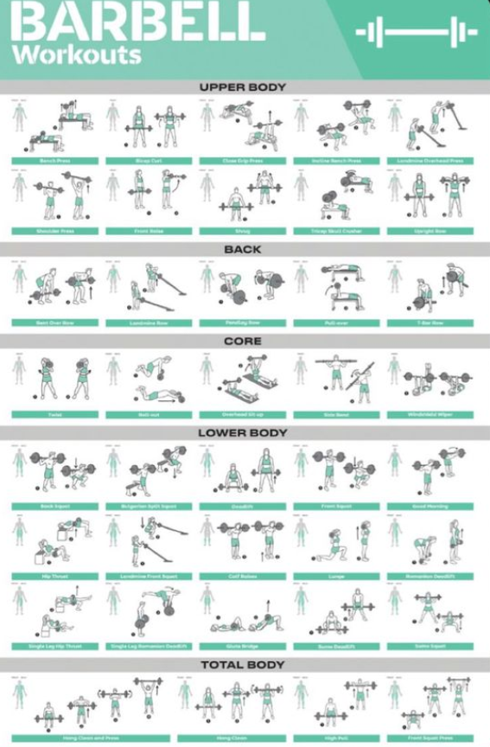
1. Introduction
1.1. Background
Barbell exercises are a type of strength training that involve lifting a barbell, a long metallic bar with weights attached to both ends.
These exercises engage multiple muscle groups simultaneously, making them efficient and effective for building overall strength and muscle mass.

Slide 4
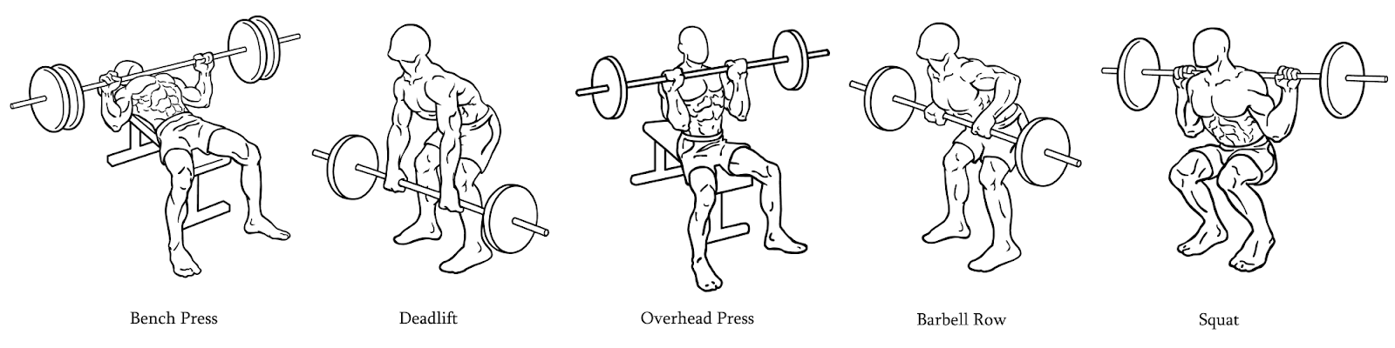
1. Introduction
1.2. Objectives
Analyze data to process and visualize model accelerometer and gyroscope data to create a ML model that can classify barbell exercises and count repetitions
Predict and give appropriate training process and routine within acceptable error rate

Slide 5
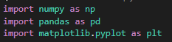

2. Statement of work
2.1. Environment Setting
These are the most used and necessary libraries:
- Anaconda V3 is in need in this project to offer flexible project organization, efficient package management, and seamless integration with popular data science tools.

Slide 6

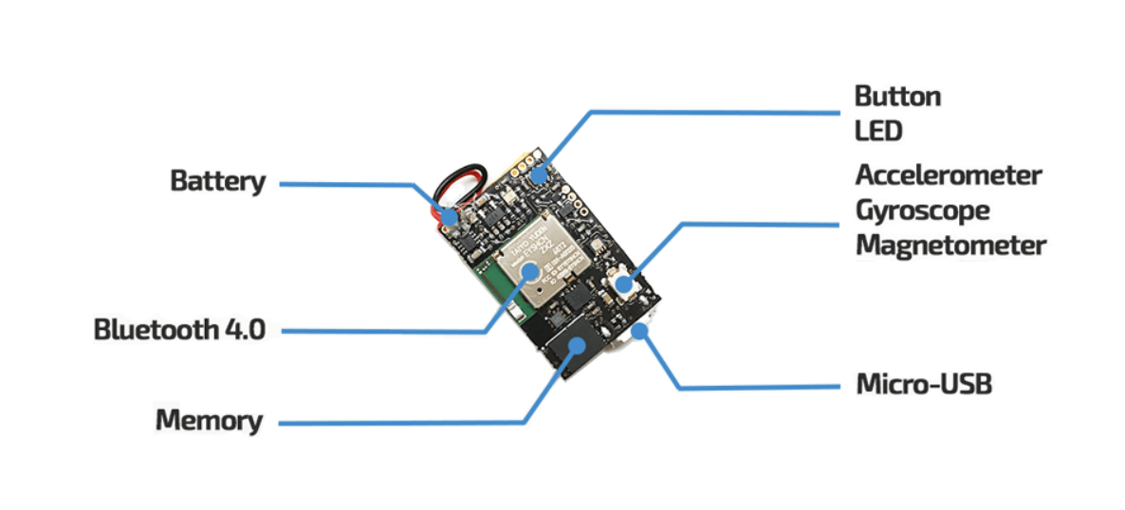
2. Statement of work
2.2. Raw Data Reading
- Our data is recorded from an open source of MetaMotions Sensor-A wearable device that offers real-time and continuous monitoring of motion and environmental sensor data.

Slide 7
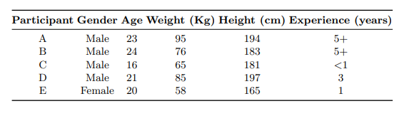
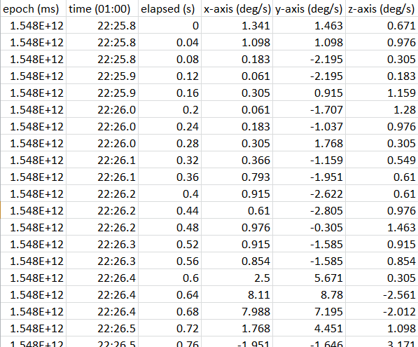
2. Statement of work
2.2. Raw Data Reading
- The data is recorded from 5 different participants and has 6 types of data. Total entries is 69677 entries.
Epoch: Starting time of an activity in xyz coordinate.
Time: epoch but in min:sec.
Elapsed: Constant step time, here is 0.2s.
X-Y-Z axis: Coordinate of a MetaMotion Sensor.

Slide 8
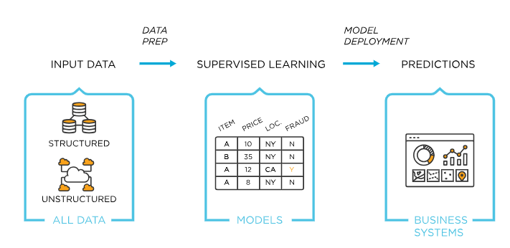
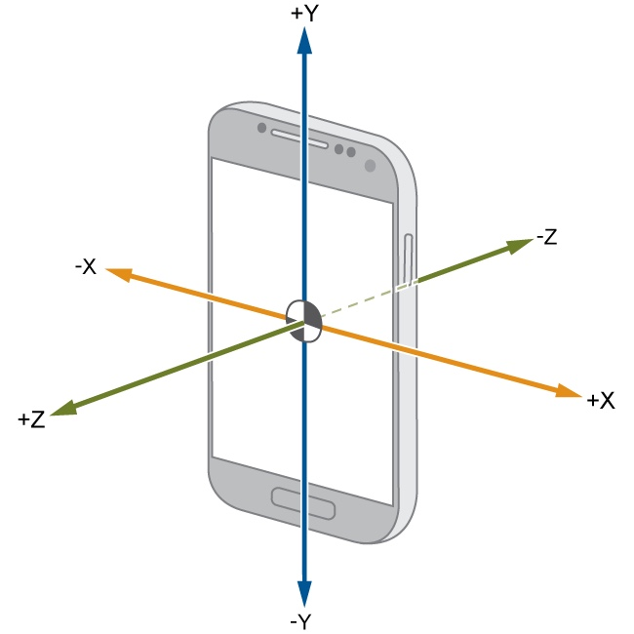
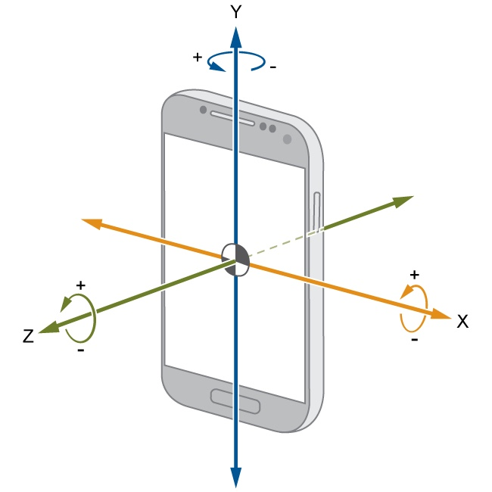
2. Statement of work
2.2. Raw Data Reading
- We use supervised learning method to label data in 5 separate exercises and resting time.
- We visualize data in 2 ways:
Accelerometer data
G-force
Gyroscope data
Angular Velocity

Slide 9
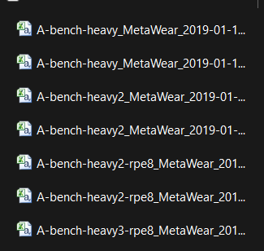
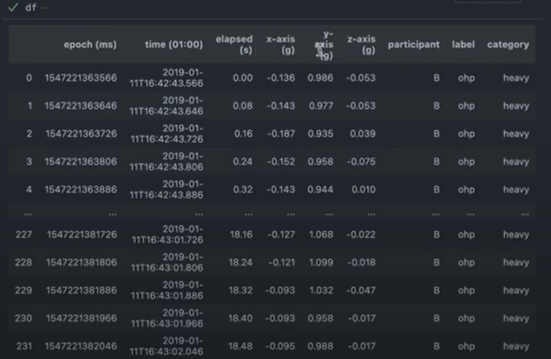
2. Statement of work
2.2. Raw Data Reading
- Starting to list files into VSC and extract features from file name to create labels and categories.
- This will assign label and category base on filename into each entry

Slide 10
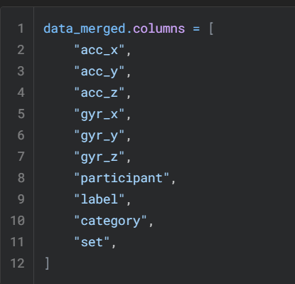
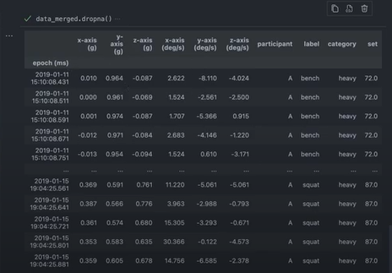
2. Statement of work
2.2. Raw Data Reading
- After labeling, create a merged file which will merge every file and their entries’ labels

Slide 11
2. Statement of work
2.3. Data Visualization
- Visualizing data to understand how accelerometer data and gyroscope data work

Slide 12
2. Statement of work
2.3. Data Visualization
- Accelerometer Data is to represent data changes in x-y-z coordinate over time.
- Gyroscope Data is to represent data changes in rotational velocity along 3 axes over time, offering deeper insights into movement and orientation.

Slide 13
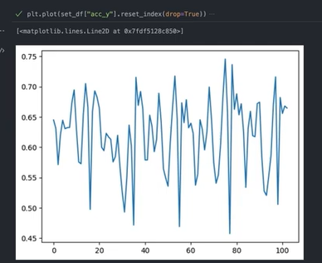
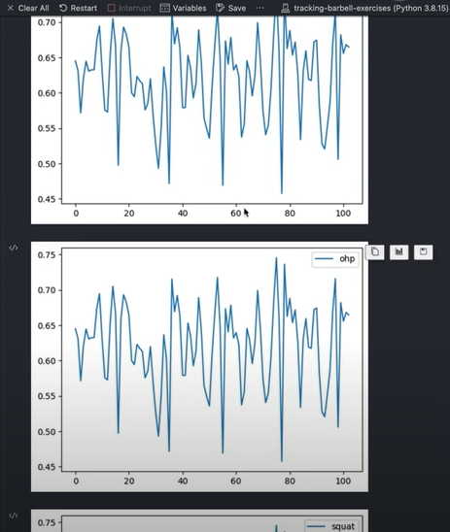
2. Statement of work
2.3. Data Visualization
- At the beginning, we try to plot only 1 column of data of 1 exercise in the merged file to understand how plotting work and to adjust how it represents unit
- Using the same format but adjusting to visualize every exercise, here we visualize every exercise of the first 100 entries

Slide 14
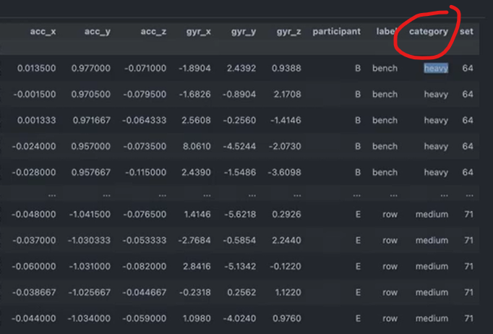
2. Statement of work
2.3. Data Visualization
Next, we visualize medium and heavy set to spot any differences between 2 categories in 1 exercise, here we choose “squat”
This will be the foundation for the sensor to understand which set we exercise

Slide 15
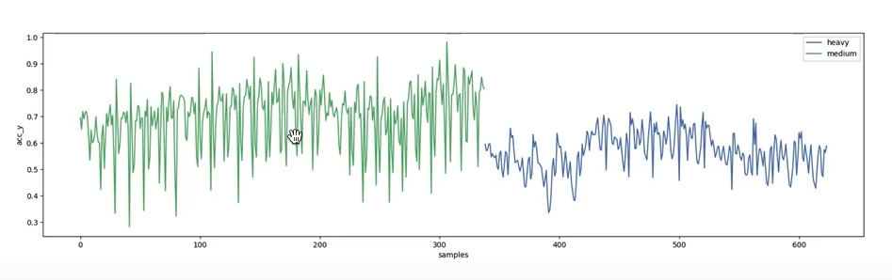
2. Statement of work
2.3. Data Visualization
We start plotting both categories.
As we can see, the changes in y-axis in medium set is huge, it means a participant dropped their barbell quickly, which is a difference in heavy set when a participant had to use a heavier barbell

Slide 16
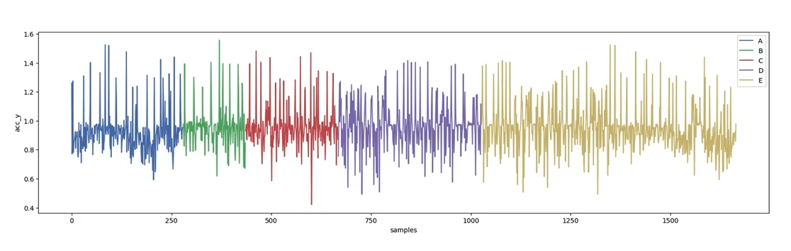
2. Statement of work
2.3. Data Visualization
We also plot the comparison between every participant in bench exercise to understand the relation between model and data set in different people with different weight and health

Slide 17
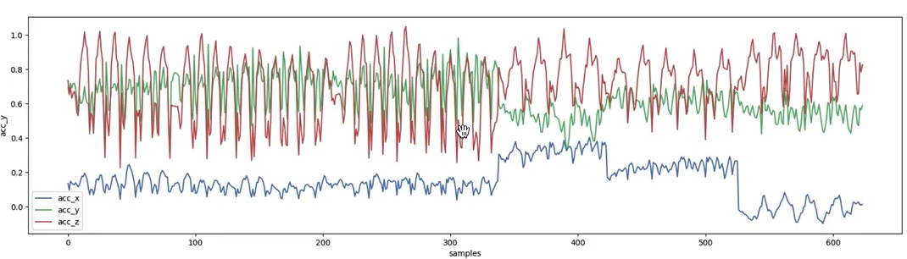
2. Statement of work
2.3. Data Visualization
Now we try to plot every axis in every exercise in 1 image, here is in squat exercise in accelerometer data

Slide 18
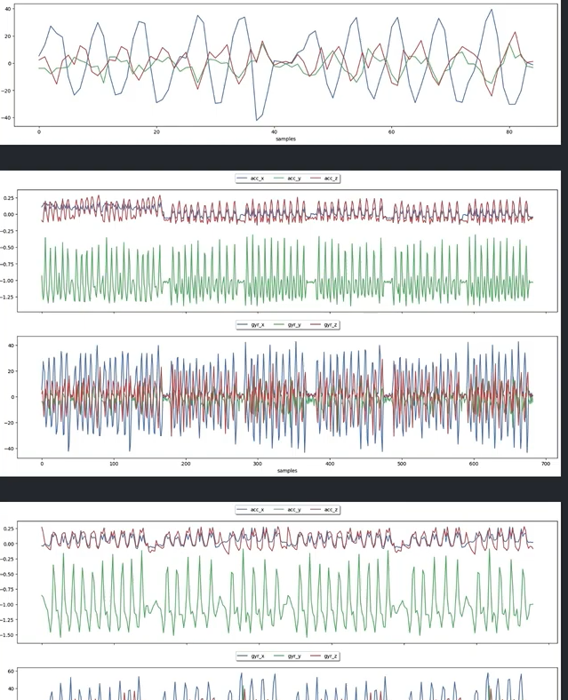
2. Statement of work
2.3. Data Visualization
The last part is to combine the plot of every participant in every exercise and export those image

Slide 19
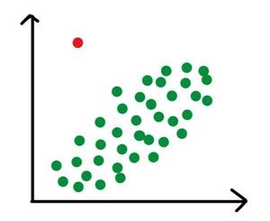
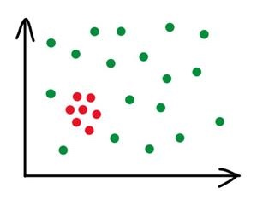
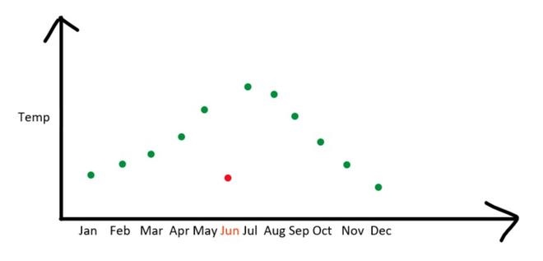
2. Statement of work
2.4. Outlier’s Detection
Outliers are extreme values in a data set that is much higher or lower than the majority of the values in the data set
Some of the problems that outliers can introduce include skewing the results of statistical analyses, leading to incorrect conclusions about patterns in the data
Global
Contextual
Collective

Slide 20
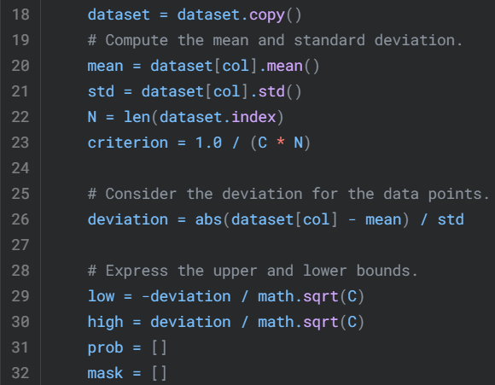
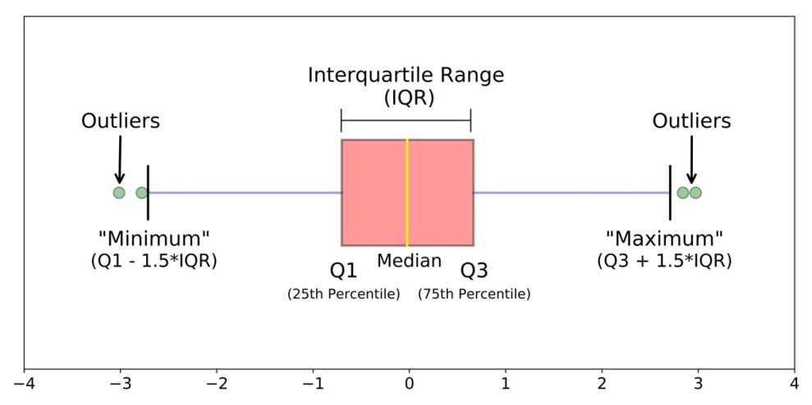
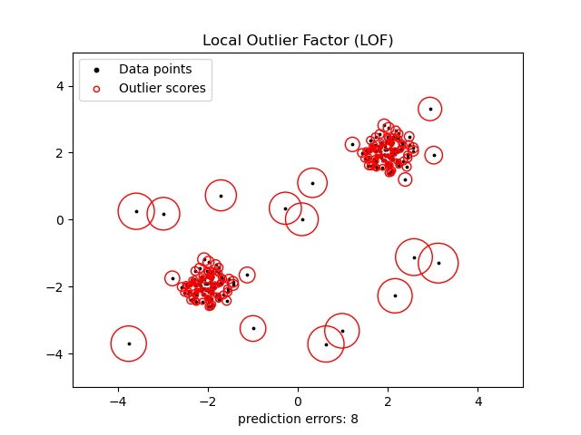
2. Statement of work
2.4. Outlier’s Detection
To detect and resolve outliers, we use these methods:
Boxplots and Interquartile Range (IQR)
Chauvenet’s Criterition
Local Outlier Factor (LOF)

Slide 21
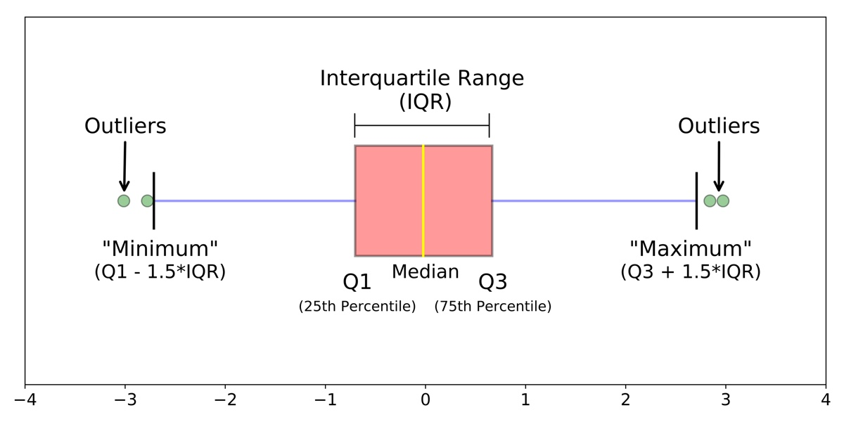
2. Statement of work
2.4. Outlier’s Detection
Boxplot and IQR method:
+ For graphically depicting groups of numerical data through their quartiles
+ The box extends from the Q1 to Q3 quartile values of the data, with a line at the median (Q2)
+ The whiskers extend from the edges of box to show the range of the data
+ By default, they extend no more than 1.5 * IQR (IQR = Q3 - Q1) from the edges of the box, ending at the farthest data point within that interval

Slide 22
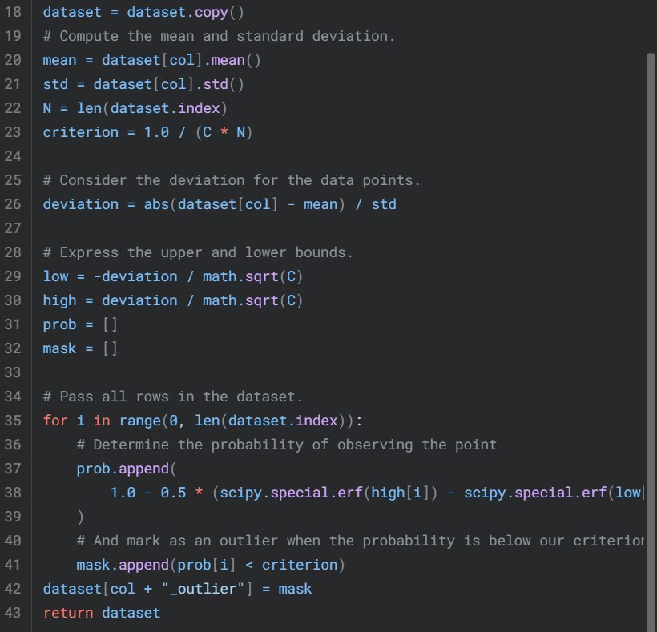
2. Statement of work
2.4. Outlier’s Detection
Chauvenet’s Criterition:
+ Only applicable to datasets that are normally distributed
+ We reject a measurement (outlier) from a dataset of size N when it’s probability of observation is less than 1/2N
+ A generalization is to replace the value 2 with a parameter C

Slide 23
2. Statement of work
2.4. Outlier’s Detection
Local Outlier Factor (LOF):
+ It measures the local deviation of the density of a given sample with respect to its neighbors
+ It is local in that the anomaly score depends on how isolated the object is with respect to the surrounding neighborhood
+ Locality is given by k-nearest neighbors, whose distance is used to estimate the local density

Slide 24
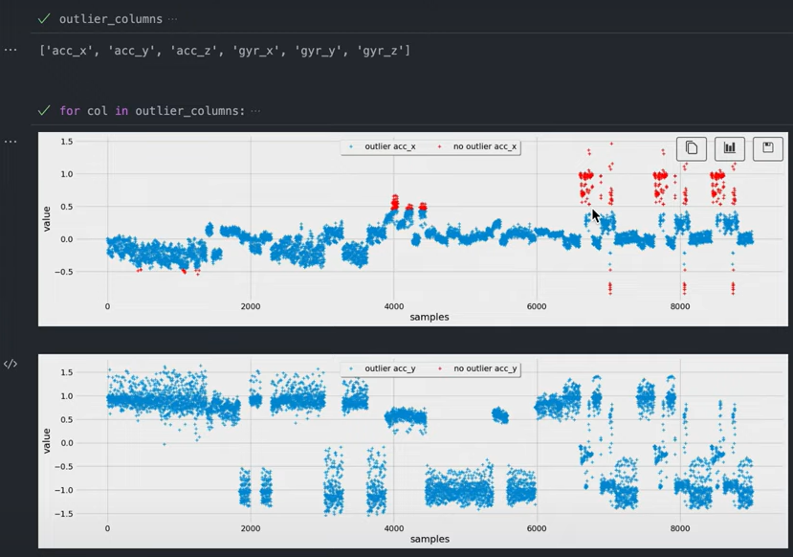
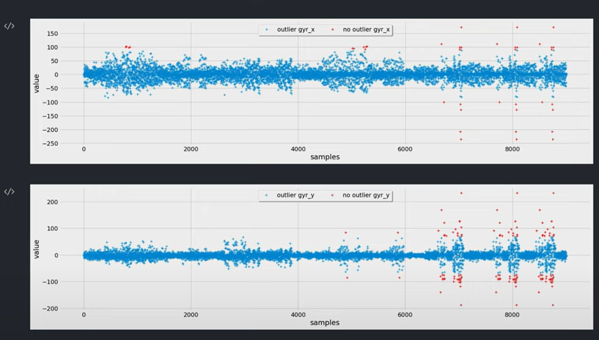
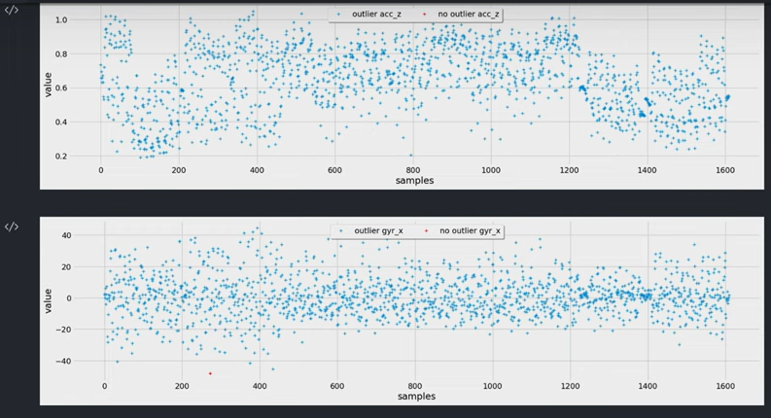
2. Statement of work
2.4. Outlier’s Detection
Chauvenet’s Criteration
IQR
- After detect and remove outliers, we export remained data
LOF

Slide 25
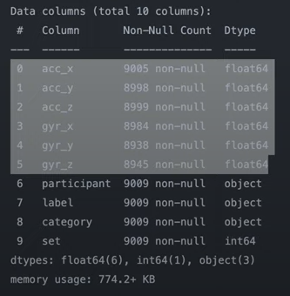
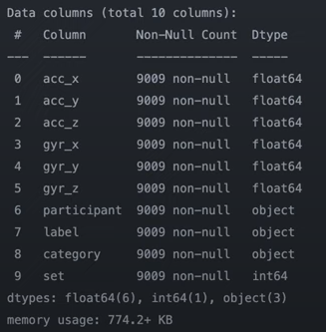
2. Statement of work
2.5. Plotting Algorithm
- In this part, we will dealing with missing values and noises in our data
When the values above or below the threshold, it will be detected as an outlier and that value will be deleted and become a missing value
What we have to do is to connect 2 values which are neighbors of the missing value

Slide 26
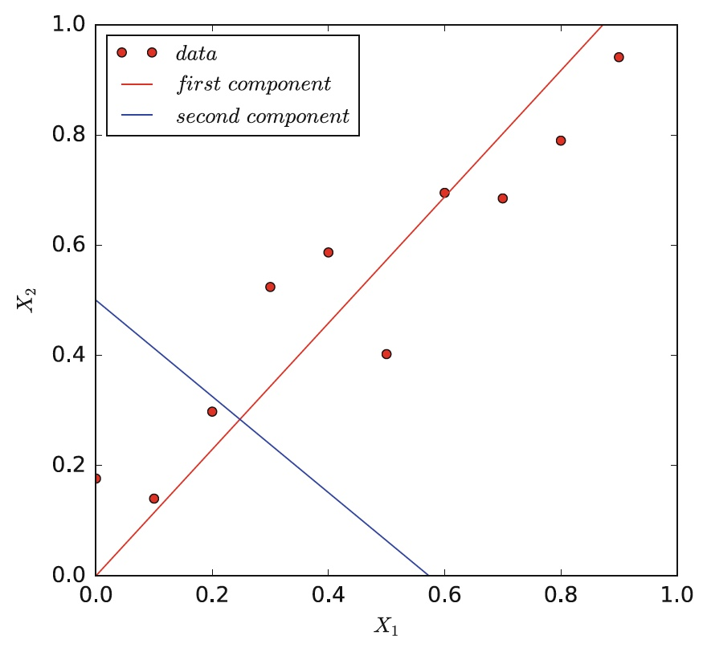
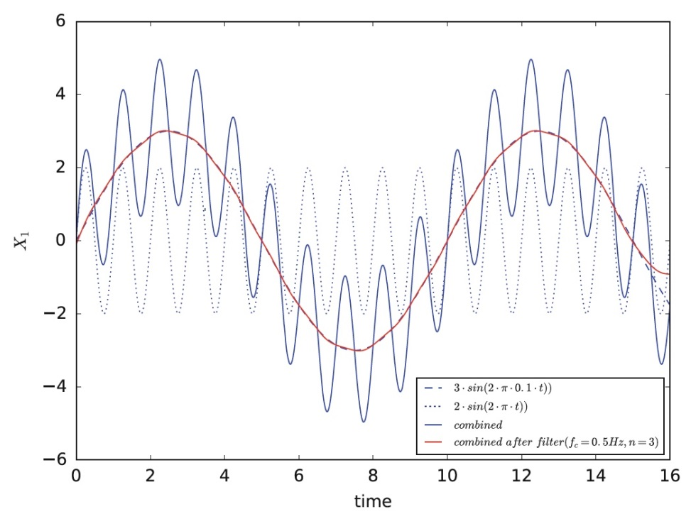
2. Statement of work
2.5. Plotting Algorithm
- To dealing with noise, we use Butterworth Low-pass Filter and Principal Component Analysis
PCA
Low-pass Filter

Slide 27
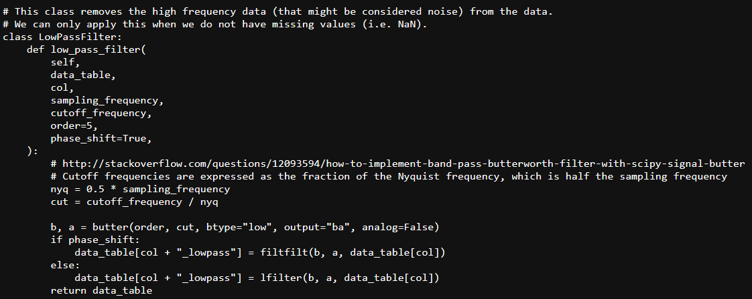
2. Statement of work
2.5. Plotting Algorithm
To use LPF, we will need the average duration of every exercise repetition and data set without missing values
Cutoff frequency will be decided how smooth you want

Slide 28
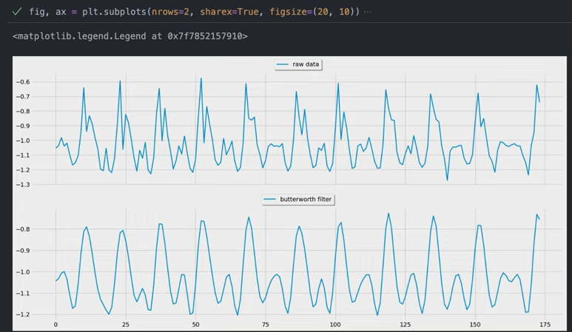
2. Statement of work
2.5. Plotting Algorithm
- This will tweak the data by removing noise as you can see in the “dead lift” exercise after tweaking with cutoff frequency = 1

Slide 29
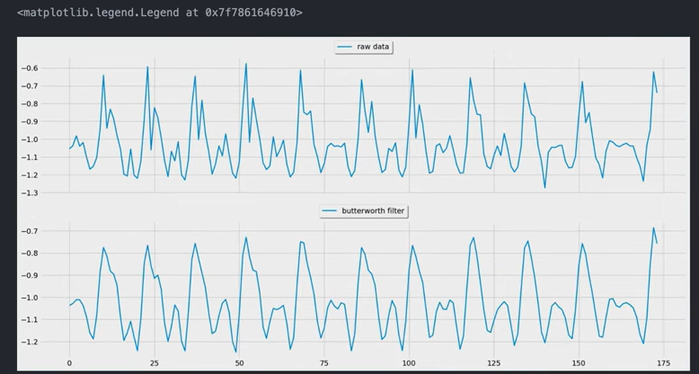
2. Statement of work
2.5. Plotting Algorithm
- We consider the cutoff frequency base on the balance between smooth lines without subtle noises but still see the apparent characteristic patterns for each exercise. Here we use cutoff frequency = 3

Slide 30
2. Statement of work
2.5. Plotting Algorithm
- After use LPF on every column and overwrite on the original columns, we start using PCA to reduce the complexity of data by transforming it into a new set of variables called principal components
To use PCA:
+ Normalize the data which is to simplify and enhance data quality
+ Determine the total amount of components we want to use by “Elbow technique”

Slide 31
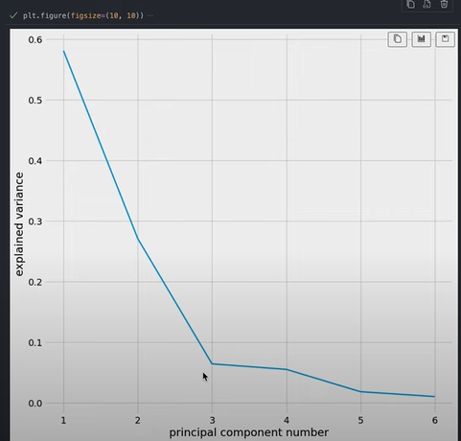
2. Statement of work
2.5. Plotting Algorithm
Elbow technique is a method used to determine the optimal number of components to use when conducting a PCA
It works by testing multiple different component numbers and then evaluating the variance captured by each component number
This is done by plotting the variance captured against the component number and then selecting the point at which the rate of change in variance diminishes (the "elbow"), as this is typically the point at which adding more components does not significantly improve the analysis

Slide 32
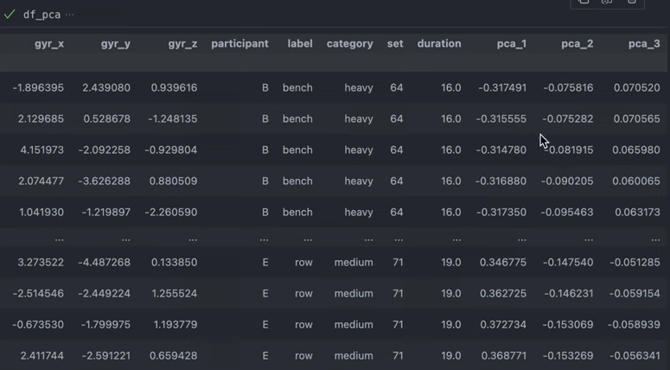
2. Statement of work
2.5. Plotting Algorithm
After that, we start applying PCA with optimal number = 3

Slide 33
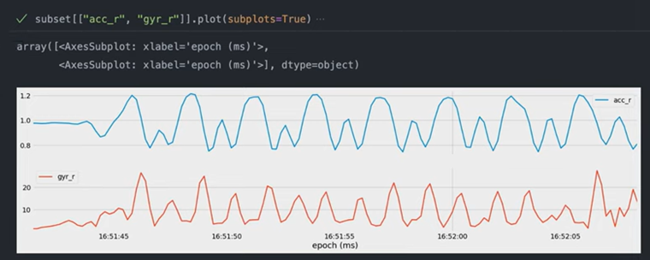
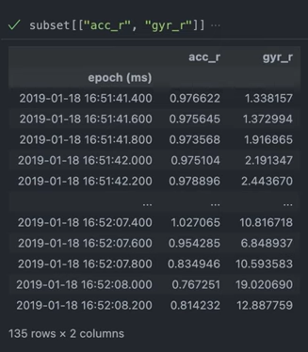
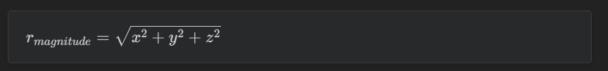
2. Statement of work
2.5. Plotting Algorithm
To further exploit the data, we now use sum of squares to calculate the scalar magnitudes r of the accelerometer and gyroscope
The advantage of using r versus any particular data direction is that it is impartial to device orientation and can handle dynamic re-orientations

Slide 34
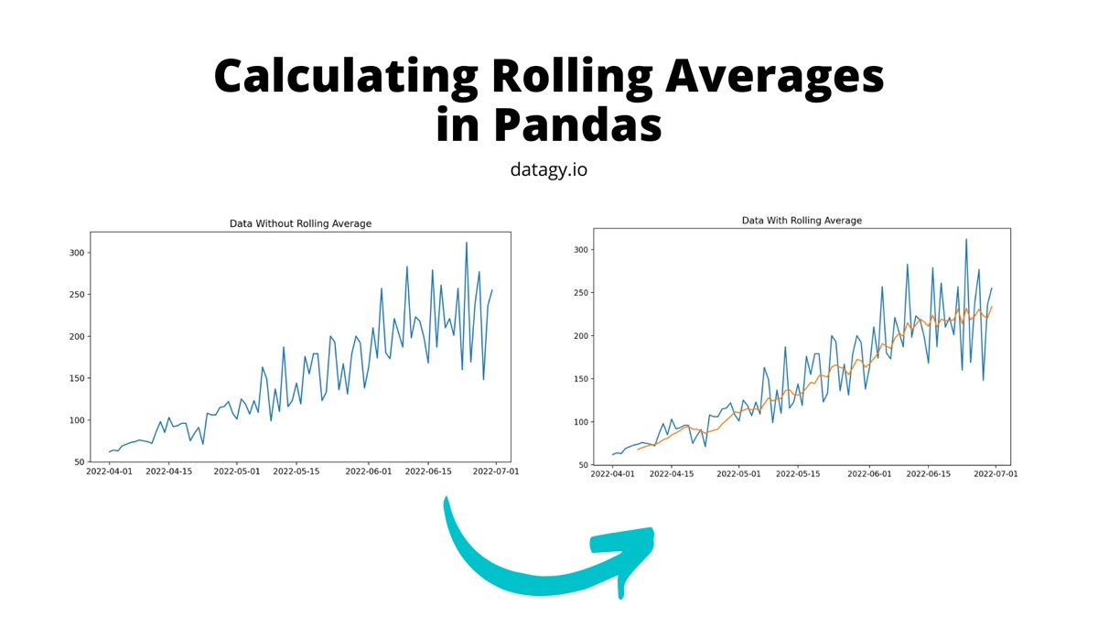
2. Statement of work
2.5. Plotting Algorithm
Next we use temporal abstraction method to calculate rolling average
This will smooth out short-term noise and highlight longer-term trends

Slide 35
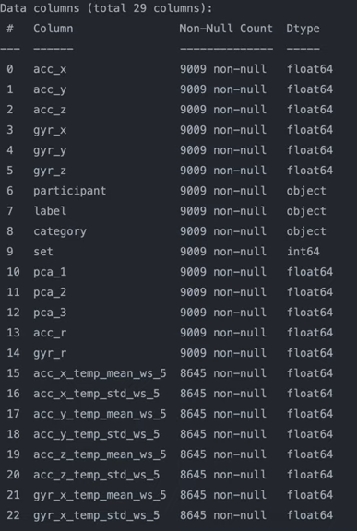
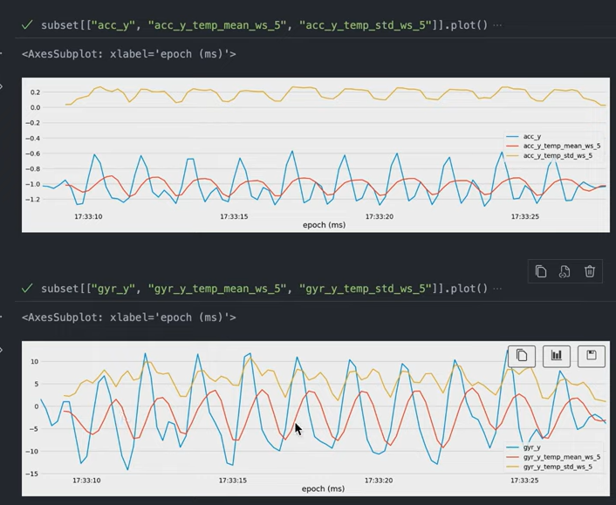
2. Statement of work
2.5. Plotting Algorithm
The rolling average can be calculated by calling back some steps (window) and finding its mean
This will leave some missing values but smoother

Slide 36
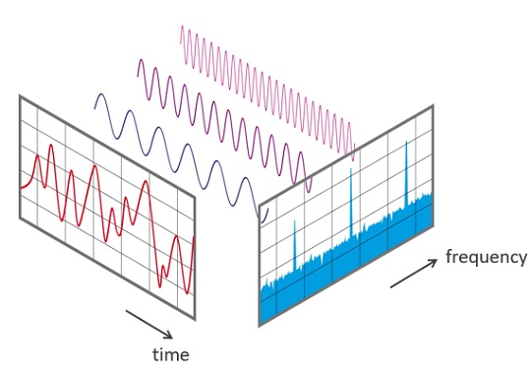
2. Statement of work
2.5. Plotting Algorithm
With temporal abstraction data, we can now do frequency abstraction using discrete fourier transformation (DFA)
It can be used to represent data in terms of frequency components, allowing for more efficient analysis of the data
DFT can provide insight into patterns and trends that would not otherwise be visible. Additionally, the DFT can be used to reduce noise, allowing for more accurate models

Slide 37
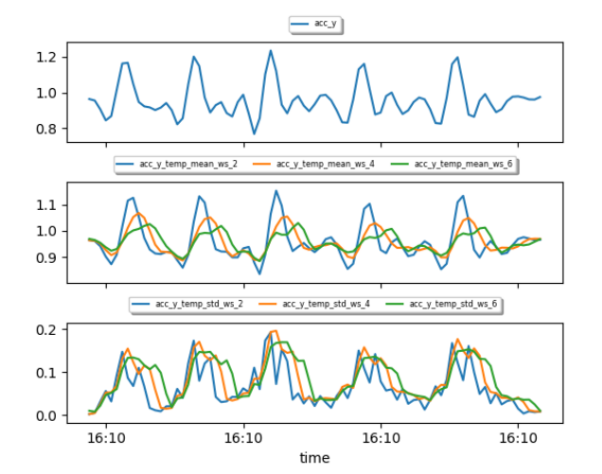
2. Statement of work
2.5. Plotting Algorithm
To use DFA, we need appropriate time domain
Here is the result for windows sizes of 2, 4, and 6 seconds
We choose 4 seconds as a main time domain

Slide 38
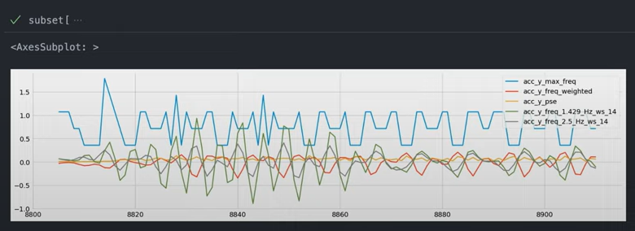
2. Statement of work
2.5. Plotting Algorithm
Now we convert to DFA as a frequency abstraction

Slide 39
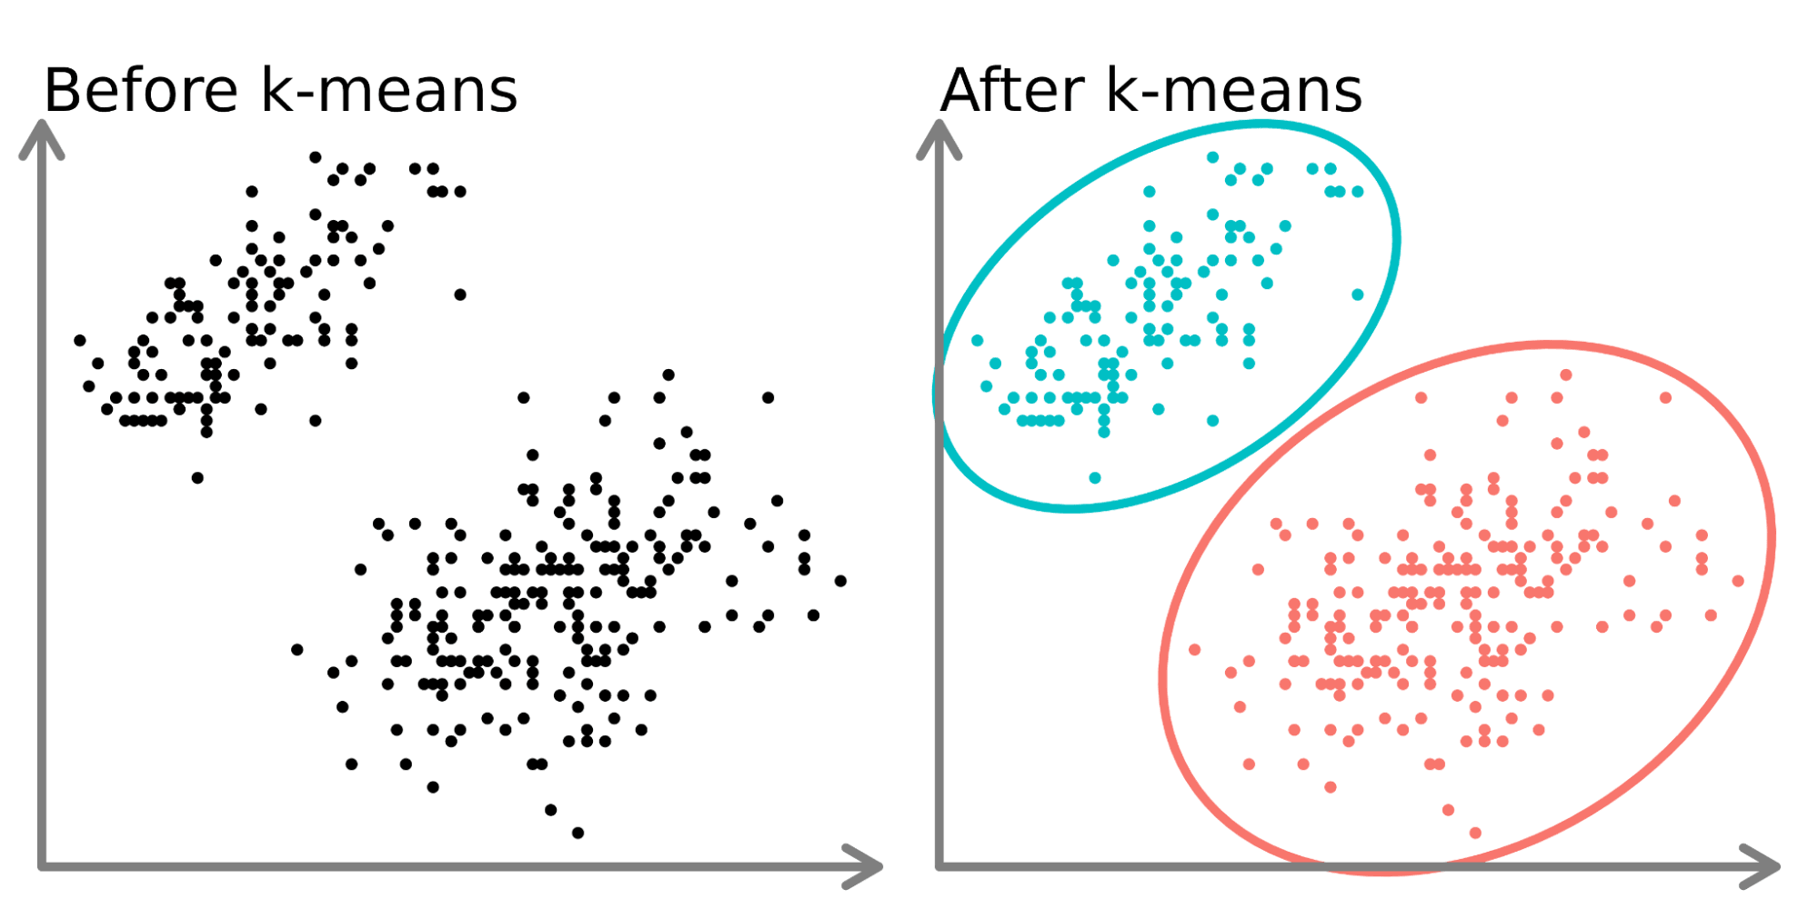
2. Statement of work
2.5. Plotting Algorithm
Now we group data into cluster by their similarity using K-means clustering
It randomly initializes k points (centroids) in the data space, calculates the distance between each data point and each centroid, and assigns each point to its closest centroid, determines the most important features in a dataset

Slide 40

2. Statement of work
2.5. Plotting Algorithm
We use “Elbow method” again to determine the optimal number of clusters for a given dataset
It plots the Inertia for each k against k and looks for the “elbow” point in the plot; this point represents the optimal number of clusters
Here we choose k = 5

Slide 41

2. Statement of work
2.5. Plotting Algorithm
Now we compare accelerometer data in clustering

Slide 42


2. Statement of work
2.6. Predictive Modeling
Modeling prediction to find highest classification accuracy
We need to create a training and testing set on all exercise and label

Slide 43

2. Statement of work
2.6. Predictive Modeling
Now we start splitting data into several feature subsets
This is to help later check for anything beneficial of the predictive performance of the models

Slide 44

2. Statement of work
2.6. Predictive Modeling
Then we put features into subsets and start training and storing performance using “simple decision tree”
A decision tree is a flowchart-like algorithm used for classification and regression. It recursively partitions data based on features and decision rules to predict labels or values. It is interpretable and captures complex relationships

Slide 45

2. Statement of work
2.6. Predictive Modeling
We train the model in the trainning set and make prediction on the tranning set
Then we store its performance from every subset for later use

Slide 46

2. Statement of work
2.6. Predictive Modeling
Then we use “grid search” to search for the best hyper parameter and model combination with highest accuracy

Slide 47




2. Statement of work
2.6. Predictive Modeling
It’s basically the way in order to come up with the set of optimal hyperparameters for your models. The model here is the scikit-learn models that we will be using all the different parameters to figure the grid search to find the optimal combination.
Using neural network training, random forest, KNN, and decision tree

Slide 48


2. Statement of work
2.6. Predictive Modeling
We plot the comparison of accuracy base on those algorithm

Slide 49

2. Statement of work
2.6. Predictive Modeling
Here we choose feature set 4
Because random forest gave the highest accuracy, we will train the data base on feature set 4 again by this algorithm
With these we can select training and test data base on participant and certain exercise

Slide 50

2. Statement of work
2.7. Counting Repetition
- From Low-pass Filter dataset we got, configure to tweak again and create counting repetition function

Slide 51

2. Statement of work
2.7. Counting Repetition
To make a counting repetition function:
+ Peak counting apply into magnitude acceleration data
+ Cutoff frequency = 0.4 to neglect small local peaks

Slide 52


2. Statement of work
2.7. Counting Repetition
To count repetition, the one rep max (1RM) metric was used.
The 1RM is the maximum amount of weight that a person can possibly lift for one repetition
Here we use Epley’s Formula to count repetition:
r: the number of repetitions performed w: the amount of weight used

Slide 53

2. Statement of work
2.7. Counting Repetition
Now we start counting repetition in several set and adjusting cutoff frequency if necessary:

Slide 54

2. Statement of work
2.7. Counting Repetition
After finding every appropriate cutoff frequency for every exercise, we start setting up repetition counting and repetition predicting
Base on the data, the overall error rate for counting repetition was about 5%

Slide 55
3. Conclusion
Wristband accelerometer and gyroscope sensor data was collected during real strength training sessions of 5 participants performing the five basic barbell lifts with medium and heavy weights.
With these we create a repetition counting and routine predicting for trainer

Slide 56

THANKS FOR LISTENING!

